Slide 1
A Level Psychology Taster Session
Miss Bennett, Miss Rigby & Mr Grange

Slide 2
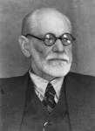
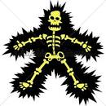
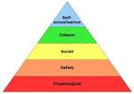
So what is psychology?

Slide 3
Task…
We are going to do a little psychological experiment to determine something about your behaviour

Slide 4
Questionnaires In psychology we complete lots of questionnaires to enable us to gather information
http://www.bemedialiterate.com/uploads/1/7/2/2/1722523/bem_androgyny_test.pdf

Slide 5
Results
You are now going to find the mean masculine and feminine scores for males and females. After you have done this you are going to plan your results in a graph. When you have completed this you have to comment on your findings.

Slide 6
What does it mean?
Sandra Bem tested her ideas about androgyny by creating a psychological test, which is known as the Bem Sex Role Inventory (BSRI). The test includes 20 masculine traits, 20 feminine traits, and 20 neutral items (distractors). When completing the inventory, an individual has to rate themselves on each trait using a 7-point Likert scale, where 1 means never or almost never true and 7 means almost always true. The scores for masculine and feminine traits calculated provide a score for femininity, masculinity and androgyny.
When the test was first developed ideas about masculinity and femininity were very different to now and while learning about gender you will find out more.. …

