Slide 1

Introduction to A Level English Literature (Lit B AQA)
kprescott@gshs.org.uk
djarvie@gshs.org.uk
awallace@gshs.org.uk

Slide 2
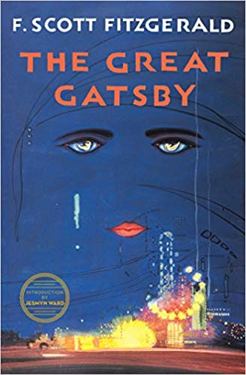

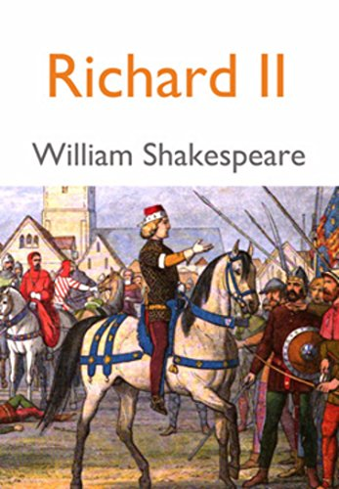
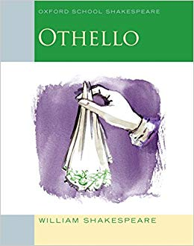
Aspects of Tragedy

Slide 3
Paper 1: Literary Genres
Choice of two options Option 1A: Aspects of Tragedy Study of three texts: one Shakespeare text; a second drama text and one further text, of which one must be written pre-1900.
Assessed: Written exam: 2 hours 30 mins Closed book 75 marks 40% of A level
Questions: Section A: One passage-based question on set Shakespeare text (25 marks) Section B: One essay question on set Shakespeare text (25 marks) Section C: One essay question linking two texts – ‘The Great Gatsby’ and ‘Richard II’ (25 marks)

Slide 4
Aspects of Tragedy
the type of the tragic text itself, whether it is classical and about public figures, like Lear, or domestic and about representations of ordinary people, like Tess
the settings for the tragedy, both places and times
the journey towards death of the protagonists, their flaws, pride and folly, their blindness and insight, their discovery and learning, their being a mix of good and evil
the role of the tragic villain or opponent, who directly affects the fortune of the hero, who engages in a contest of power and is partly responsible for the hero’s demise
the presence of fate, how the hero’s end is inevitable
how the behaviour of the hero affects the world around him, creating chaos and affecting the lives of others
the significance of violence and revenge, humour and moments of happiness
the structural pattern of the text as it moves through complication to catastrophe, from order to disorder, through climax to resolution, from the prosperity and happiness of the hero to the tragic end
the use of plots and sub-plots
the way that language is used to heighten the tragedy
ultimately how the tragedy affects the audience, acting as a commentary on the real world, moving the audience through pity and fear to an understanding of the human condition.

Slide 5
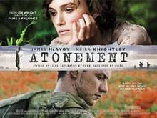
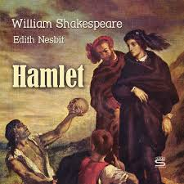
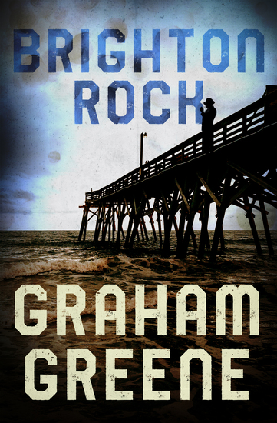
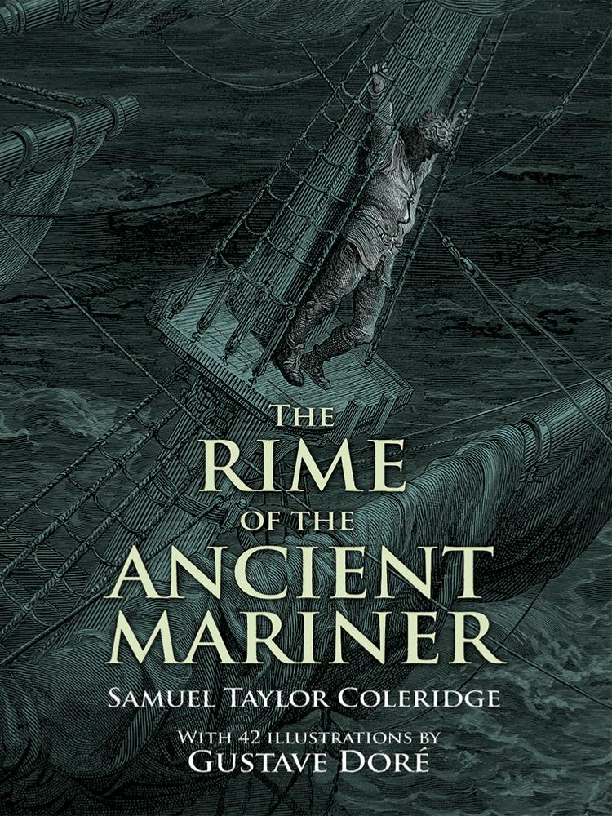
Paper 2
Elements of Crime Writing

Slide 6
Paper 2: Texts and Genres
Choice of two options: Option 2A: Elements of Crime Writing Study of three texts: one post-2000 prose text, one poetry and one further text, one of which must be written pre-1900. Examination will include an unseen passage.
Assessed: Written exam: 3 hours Open book 75 marks 40% of A level
Questions: Section A: One compulsory question on an unseen passage (25 marks) Section B: One essay question on set text (25 marks) Section C: One essay question which connects two texts (25 marks)

Slide 7
The Elements of Crime Writing:
The significance of place/ setting
The criminal and the narrative voice
Narrative structure (ways in which the criminal is revealed through their place in the structure of the narrative)
Narrative language e.g. confessional, self-justification etc
The criminal as a victim
The isolation of the criminal
The crime
Detection- focaliser or interpreter of stories
Crime writing as a moral genre (guilt, suffering, moral and social structures of the environment, law and justice, the consequence of the crime, religious implications)
Motives/motivations
The victim
Bodies and corpses (the way in which the corpse appears e.g. bloody and violent or brief description)
Guilt
Punishments administered by society and law (justice- as an abstract and moral concept, law- as a series of rules set down by specific human societies)

