Slide 1
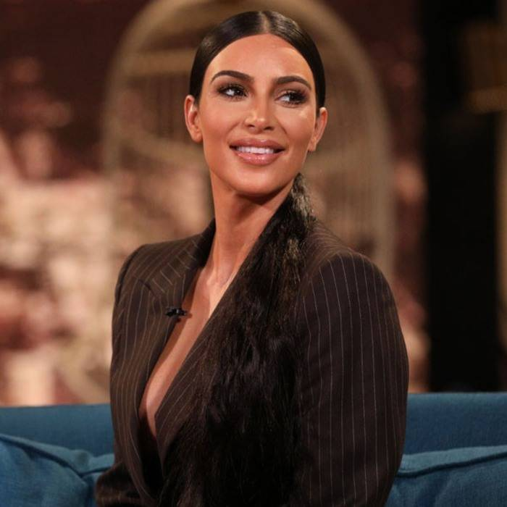

Was Kim Kardashian born or made?

Slide 2


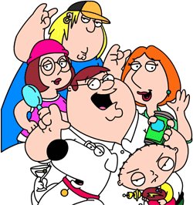
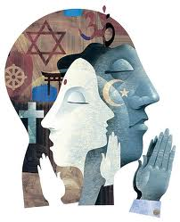

Sociology: Nurture is the biggest factor in choosing someone’s identity.
The Media
The Law
Education
The Family
Religion

Slide 3
What is Sociology?
Sociology is the study of society.
It looks at how individuals are shaped by the society they live in and how individuals create society.

Slide 4
Your task.
You are going to imagine that you have been in a plane crash and survived!
The plane crash landed on a desert island and you, along with 41 others have little hope of being rescued.
You have been chosen as the leader of your island society and must make some decisions about how you will organise your society!
Answer the questions on slide 5 and think about how you would respond to the challenges on slide 6

Slide 5

Where will people live?
How will you educate children?
What will you do with people who cannot contribute/ work?
How will you allocate jobs?
What would you do with people who break the rules?
How will you pay people for their work?
What rules would you have?
How will you decide your limited supply of medicine will be given out?

Slide 6
Challenge 1: One of your islanders claims that they have a bad back. However, people believe that they are faking this and that they are work shy. They say they can’t work and eat the food. What do you do? | Challenge 2: Since being stranded on the island, people have started to get together and now, six months later, 2 couples have announced that they are pregnant. What issues will arise due to this and how will you deal with them? | Challenge 3: There are 2 men on the island whose personalities clash. They argue over food, the quality of each other’s shelters, the jobs they do. One night, one of them hits the other and a fight breaks out. What will you do?
Challenge 4: You have an elderly woman on the island who is in very poor health. She cannot work and requires around the clock care. She is in massive pain due to injuries and is using up some of the limited pain medicine. What do you do? | Challenge 5: You have caught a woman stealing food and medicines as well as some of the belongings of the other islanders. She explains that before she came to the island, she suffered from kleptomania- a mental illness where the sufferer steals things. What do you do? | Challenge 6: 2 young children were orphaned in the crash. They don’t know anyone on the island and seem very scared. There are 8 other children on the island but these 2 youngsters keep themselves to themselves. What do you do?

Slide 7
A Level Sociology.
 | Year 1 | Year 2
 | Families and Households. Why do people live in families? How is the family changing? What type of families do people live in? Who is responsible for housework? Is the best time in history to be a child? | Beliefs in Society. Why are people religious? Does religion aid change or stop it? Why do people join suicide sects? Why is there an increase in religious fundamentalism? Does religion matter anymore?
 | Education and Methods. How does the government affect the UK education system? Why do girls do better than boys in school? How do sociologists do research? What research methods are the best? | Crime and Deviance and Theory and Methods. Who commits crime in society? Why do the media portray crimes as they do? Why do people join gangs? Is sociology a science? Do we live in a postmodern society?

Slide 8
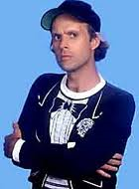
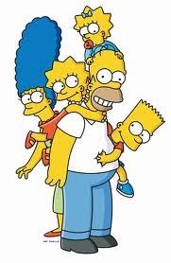
Families and Households.
I am George Murdock.
I believe the nuclear family is universal.
The Nuclear Family is:
Father + Mother + Their Children.

Slide 9

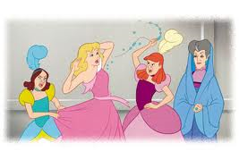
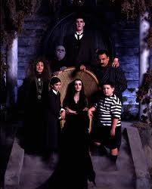
Is the Nuclear Family Universal?
Nuclear family:
Mother + Father +
Their Children.
Lone Parent Family:
One parent + their children.
Extended Family:
Grandparents+ Parents+ Their Children.
Stepfamily:
Mother+ Father+ Children from previous relationships.

Slide 11
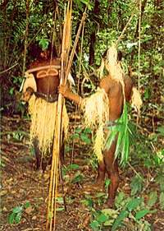

The Nayar Tribe
The Nayar tribe lived in South India prior to British rule in 1792.
Kathleen Gough (1959) studied the Nayar and found that once a female reached puberty, she would take a number of “sandbanham” husbands. The “Sandbanham” husbands were typically warriors and would be away for long periods. When they returned, they would stay with their “wife”. A woman would typically have up to 12 visiting husbands and these unions were not lifelong and either party could terminate them at any time.
The Sandbanham husbands did not take responsability for any offspring. Any man in the community could claim to be the father and support the woman with the cost of the child. Often it would be left to the woman’s brother to help support the woman with her children.
Gough believed that this example countered Murdock’s claim as there was no “marriage” in the Westernised sense nor was the biological parents an economic unit supporting their children.

Slide 12
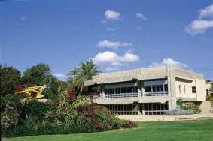
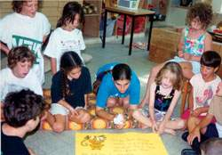
Kibbutz System (Israel)
Kibbutzim are collective communities and in Israel, 4% of the population live in them. All the members of kibbutz work to help it and this includes sharing childcare.
Until recently, the children would live separate from their parents in children dormitories where they would live with the other children from the community. They would spend some leisure time with their biological parents though the children were thought of the children of the entire community.
Nowadays, children typically live with their parents in the kibbutz though will spend their days apart from their parents, being looked after by other members of the community whose role is to look after the children.
As an example of communal living and shared responsibility for child rearing, this suggests that the nuclear family might not be universal.

Slide 13
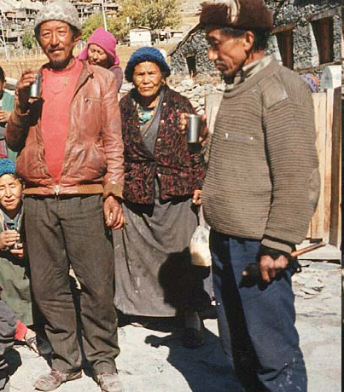
Polyandrous Families in Nepal.
Polyandry is where a woman has more than 1 husband. It is often practised in countries with limited natural resources in order to limit the number of children born.
Polyandry is practising in Nepal where a woman will marry all the brothers or male cousins within a family.
The children of the woman are considered to be the children of all her husbands and will be treated as such. This insures that if one of the woman’s husbands dies (due to the hard conditions of life), then she and her children will be taken care of by her other husbands who are biologically related to the offspring and regard them as their children.
Whilst this may prove the importance of the family as an unit of economic cooperation, it does not involve two adults of different genders engaging in a socially approved sexual relationship as polyandry is illegal within Nepal.

Slide 14
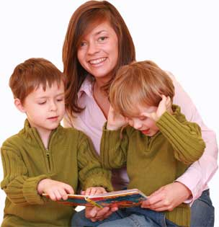
Female- Carer Core.
Yasmin Sheeran argued that the female- care core is the most common basic unit of family. By this, Sheeran means that the primary carer in families tends to be female, with or without the support of a partner or help from the extended family.
Sheeran claims that this is typical of most societies regardless of whether it is a contemporary society or a pre-industrial society. Also, it includes families which would not under Murdock’s nuclear families, such as lone parent families (which are typically female headed) and lesbian families (though it does not include gay families).
Sheeran also recognises that the primary carer of a child may not be its mother- if it is not, it is typically a female relative such as grandmother or sister. Sheeran is not denying that men play an important role in the upbringing of their children but she is highlighting that it is typically women who act as primary care givers.

Slide 15
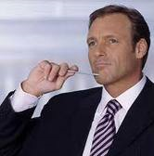
Any Questions?
Is there anything else I need to know?
arigby@gshs.org.uk
rbennett@gshs.org.uk

